Slide 1
The
Netflix EDA
Nur Liyana Binte Roslie

Slide 2
TABLE OF CONTENTS
PROBLEM STATEMENT
01
DATA CLEANING PROCESS
02
DATA INSIGHTS
03
Overview of the insights to uncover
Overview of the actions taken to clean all datasets and merge them together
Questions, interpretations and recommendations that covers problem statements

Slide 3
01
PROBLEM STATEMENT
Overview of the insights to uncover

Slide 4
PROBLEM STATEMENT
To uncover insight on what kind of Netflix contents that will be enjoyed and well-received by the viewers
How well content is enjoyed is mainly determined by the average weighted rating and total votes casted provided by IMDB
The types of contents such as MPAA rating, genres, description, original content
Other factors that may affect the likability of the contents includes director, cast, country, release year, duration
Uncover any correlations, trends with all the factors mentioned above

Slide 5
PROBLEM STATEMENT SUMMARY
PERFORMANCE
IMDB Rating
No of votes casted
PROBLEM STATEMENT
The type, factors, relations that determine how well the content is liked by many viewers
CONTENT TYPE
OTHER FACTORS
Movies or TV Shows
MPAA rating
Genres
Description
Original Content
Director
Country
Release Year
Duration

Slide 6
02
DATA CLEANING PROCESS
Overview of the actions taken to clean all datasets and merge them together

Slide 7
DATA CLEANING PROCESS
THE FILES
Main Netflix dataset (csv)
Only Netflix original content dataset (csv)
Two imdb datasets (tsv)
THE STEPS
Merge the first 2 files
Delete the columns and records that are duplicated across the files and columns that contain too many missing information
The records that are missing are replaced with either 0 or No info depending on data type
Merge imdb datasets to the merged Netflix dataset
Repeat step 2 and 3
Export final dataset to local machine for checking purposes

Slide 8
03
DATA INSIGHTS
Questions, interpretations and recommendations that covers problem statements

Slide 9
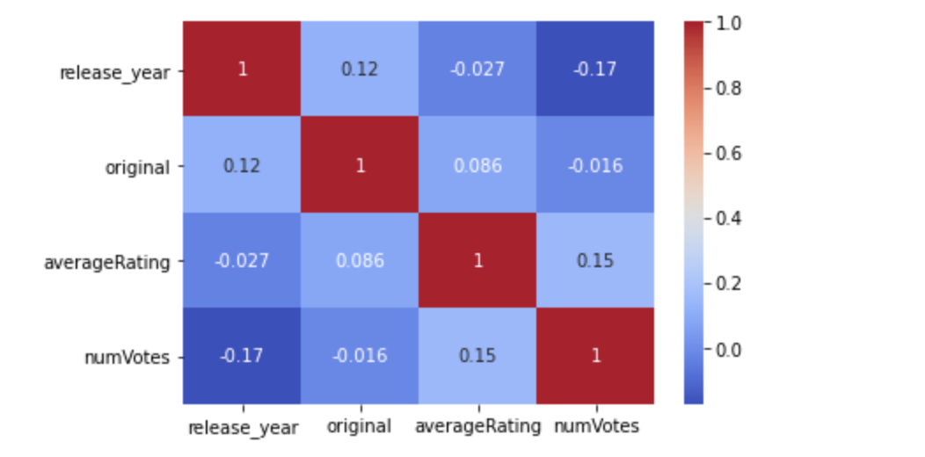
INSIGHT 1
NO STRONG CORRELATION FOUND
Have to inspect each factors individually

Slide 10
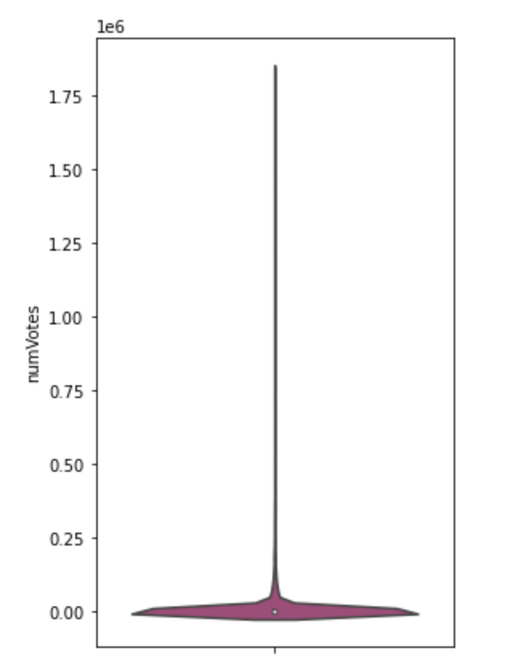
INSIGHT 2
NUMBER OF VOTES
Many outliers are located in the upper range
Deduce that viewers would only cast their vote when the shows make certain impression or has certain impact
Wide range of votes
Votes that fail to reach at least the median will be filter off as these shows could be for very small set of audience or does not have great impact/impression

Slide 11
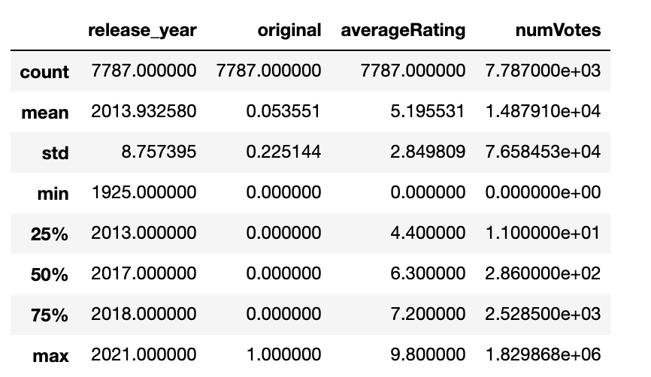
INSIGHT 3
FilTERING DATASETS
Filter off datasets that does not MEET the MEDIAN votes and meet UPPER percentile of averageRating

Slide 12
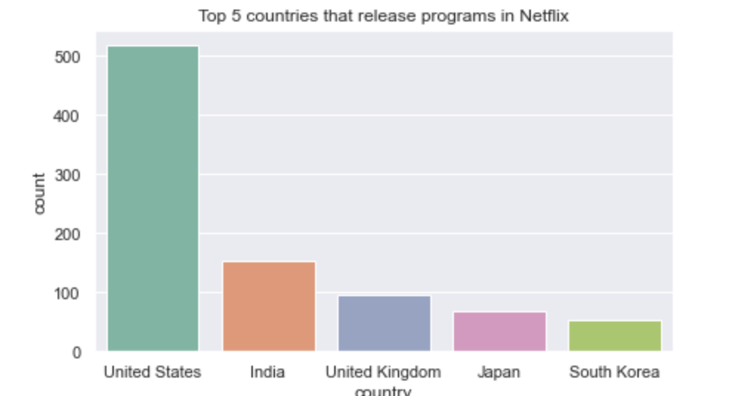
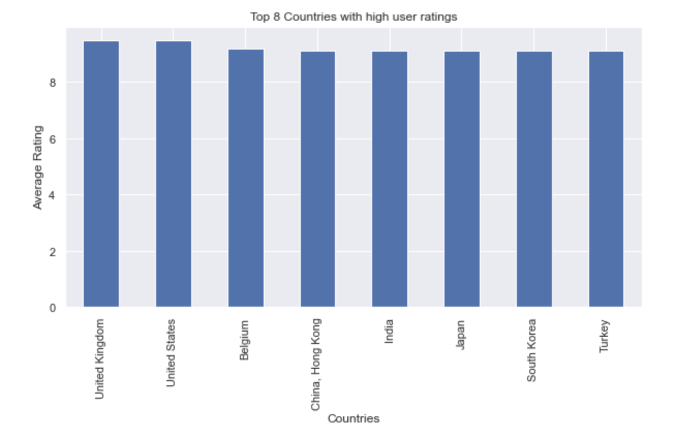
INSIGHT 4
COUNTRY FINDINGS
All 5 countries available in Netflix produce relatively good content with high user ratings

Slide 13
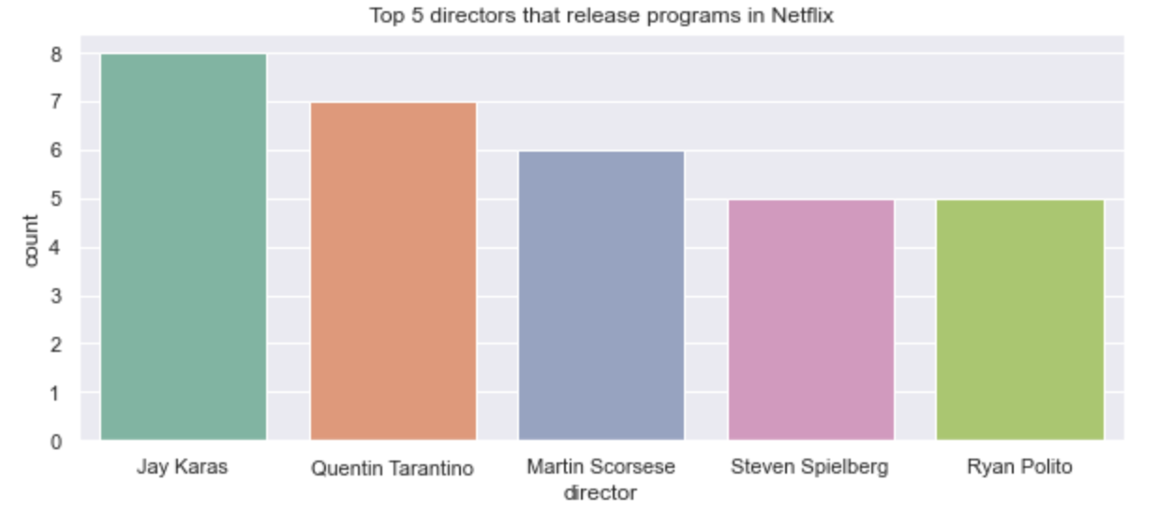
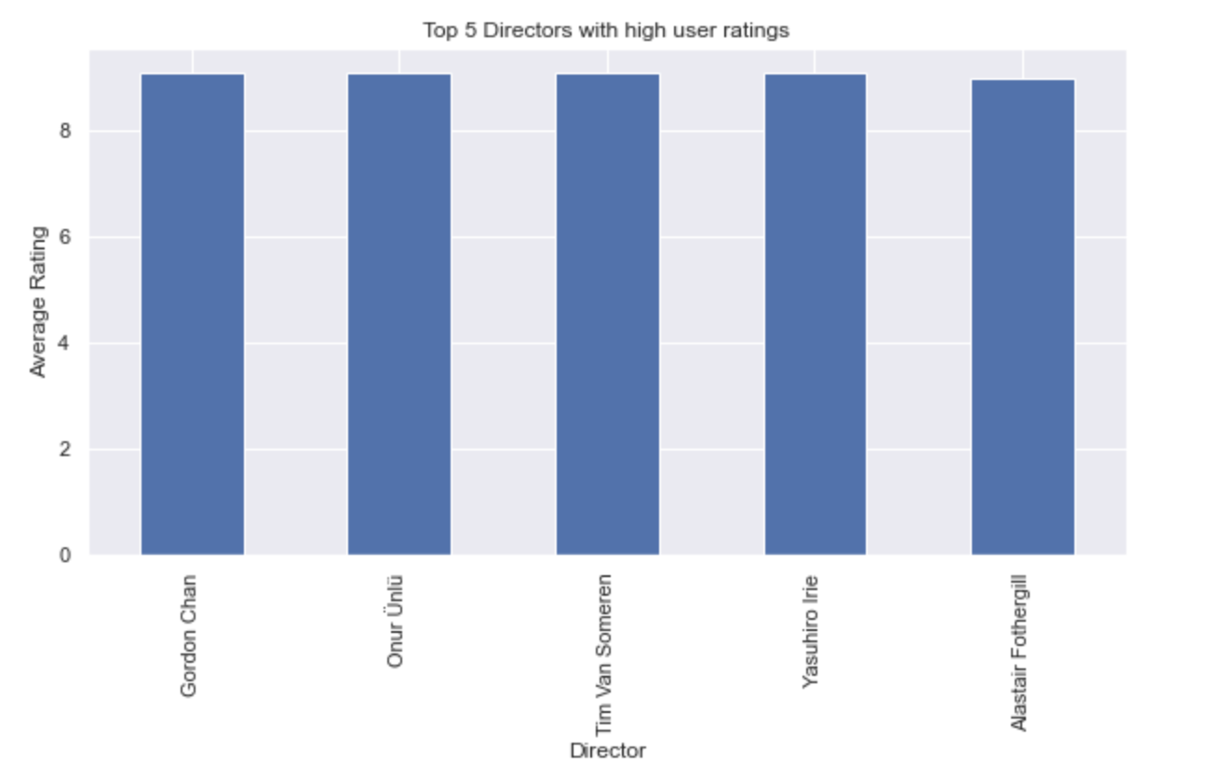
INSIGHT 5
DIRECTOR FINDINGS
The top 5 directors in Netflix and the top 5 directors with very high user ratings are totally different.
In fact, the directors with very high user ratings appear to be Non-American directors from other countries
Netflix can consider to upload more of these directors shows and do some marketing for them so that they can be discovered by more viewers

Slide 14
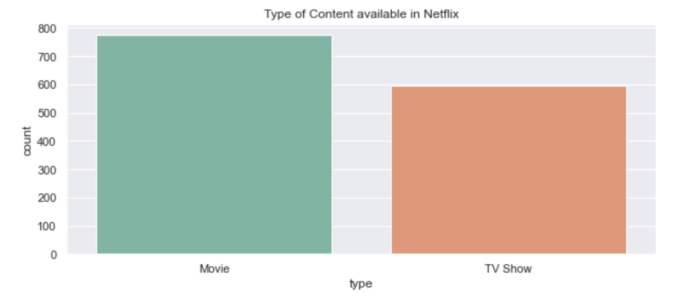
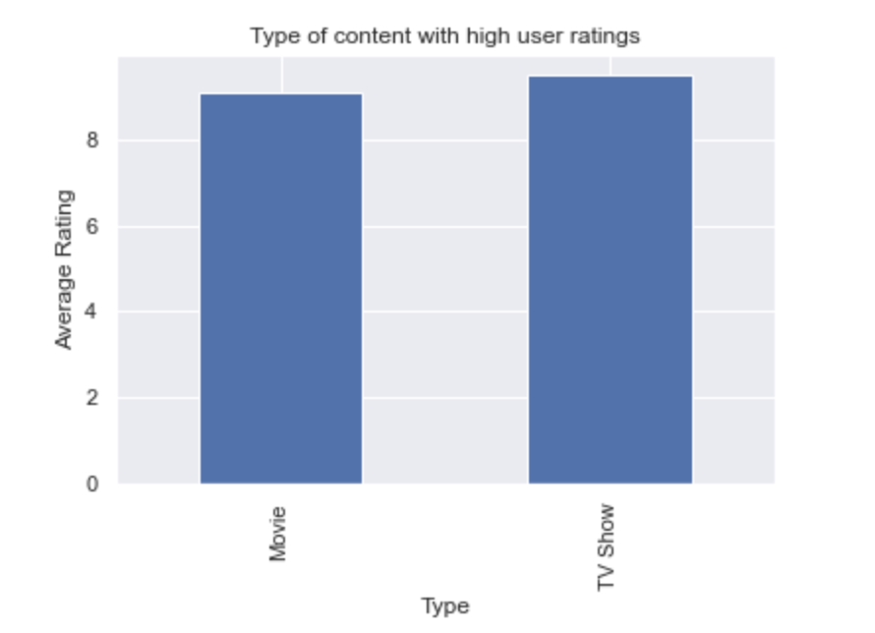
INSIGHT 6
CONTENT TYPE FINDINGS
More movies compared to TV shows available in Netflix
This could be because TV licenses to broadcast content are harder to obtain

Slide 15
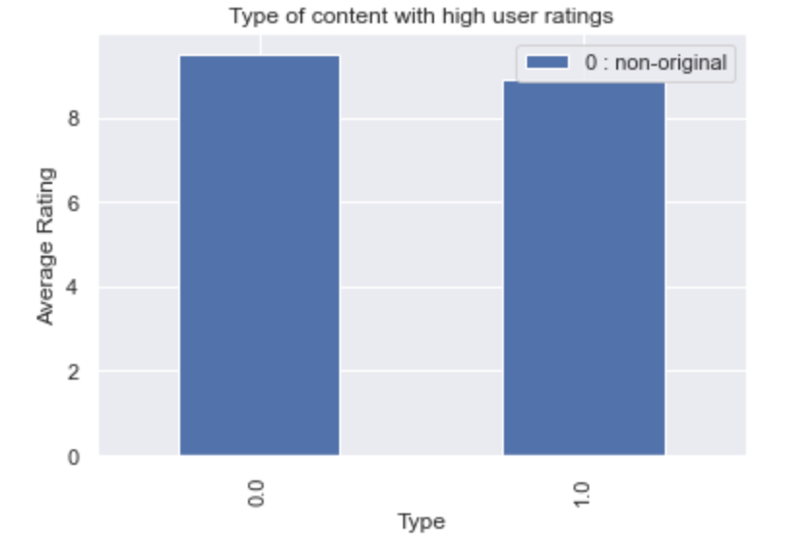
INSIGHT 7
ORIGINAL CONTENT FINDINGS
Non-original content has slightly higher user ratings but Netflix original content still performs comparatively well. It makes sense for Netflix to continue to produce their own TV shows as their content are good and it would bypass the need to obtain more non-original TV shows as they are harder to obtain

Slide 16
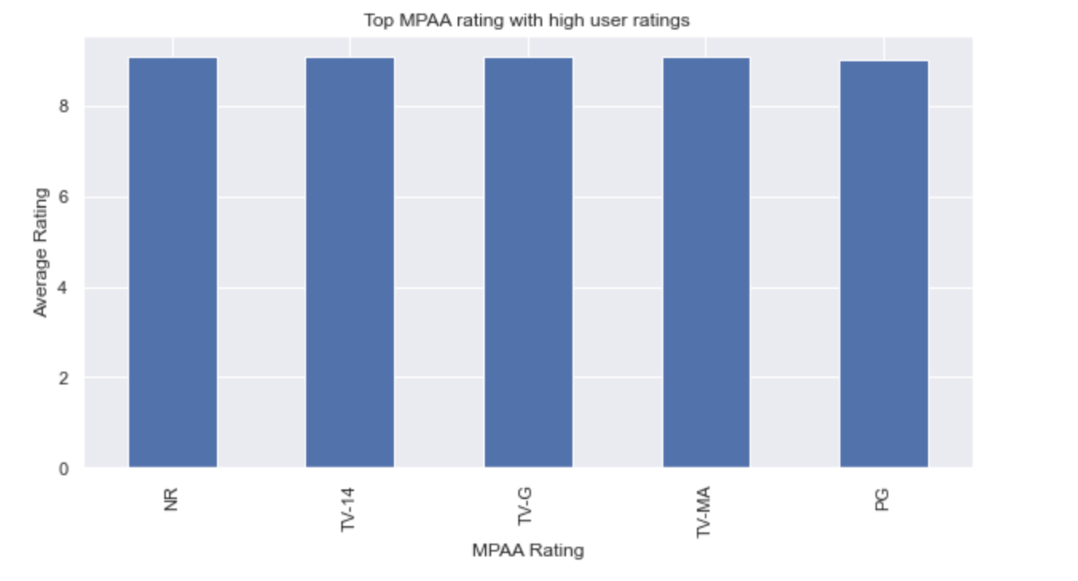
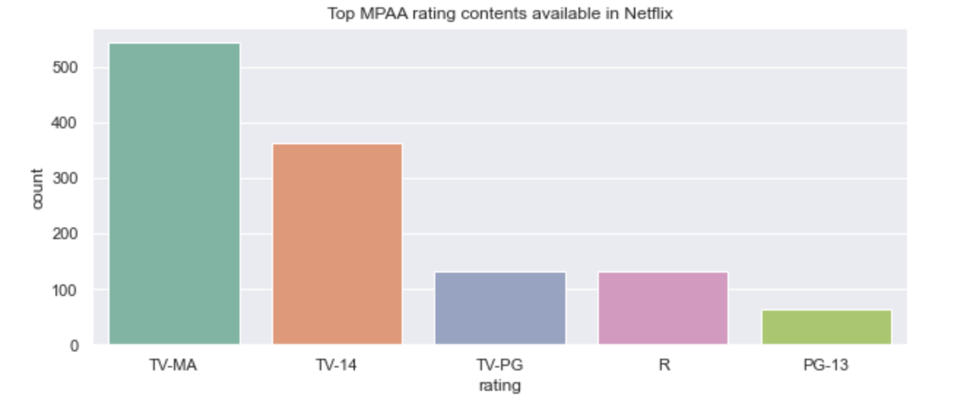
INSIGHT 8
MPAA RATING FINDINGS
Netflix content shows are geared mainly towards adults but in terms of high user ratings, audience preference does not really discriminate between adults or child friendly shows. To increase viewership, Netflix can consider to implement features to restrict children from viewing adult content, as this can reassure parents to leave their children to watch content on Netflix on their own

Slide 17
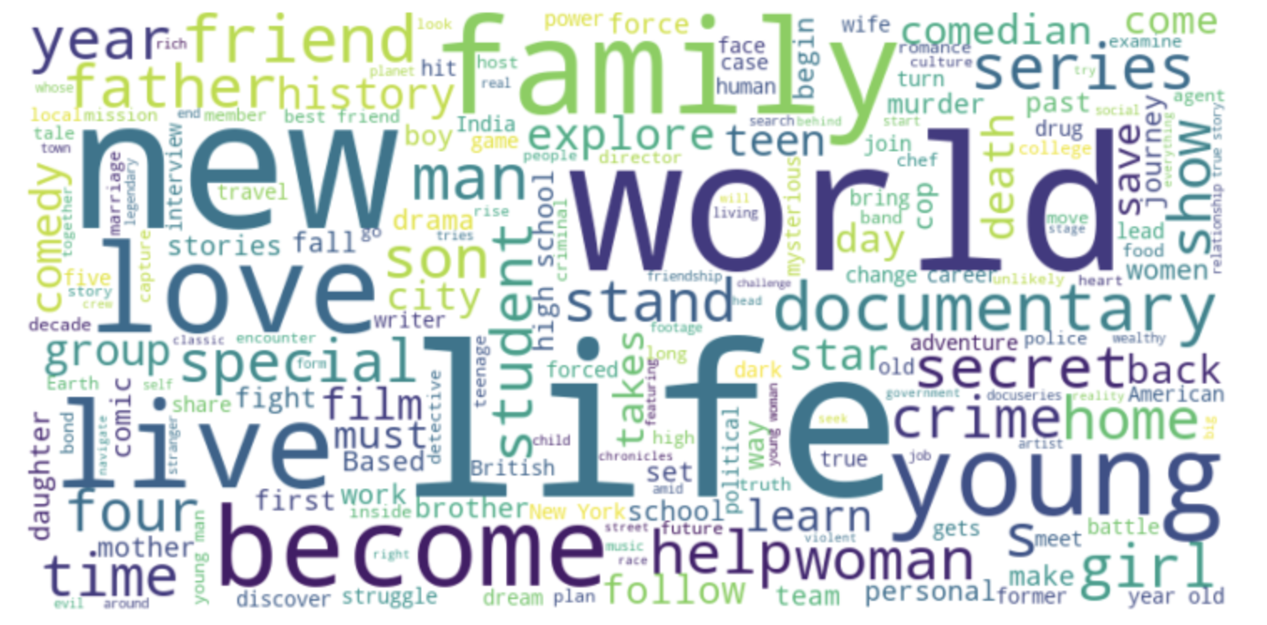
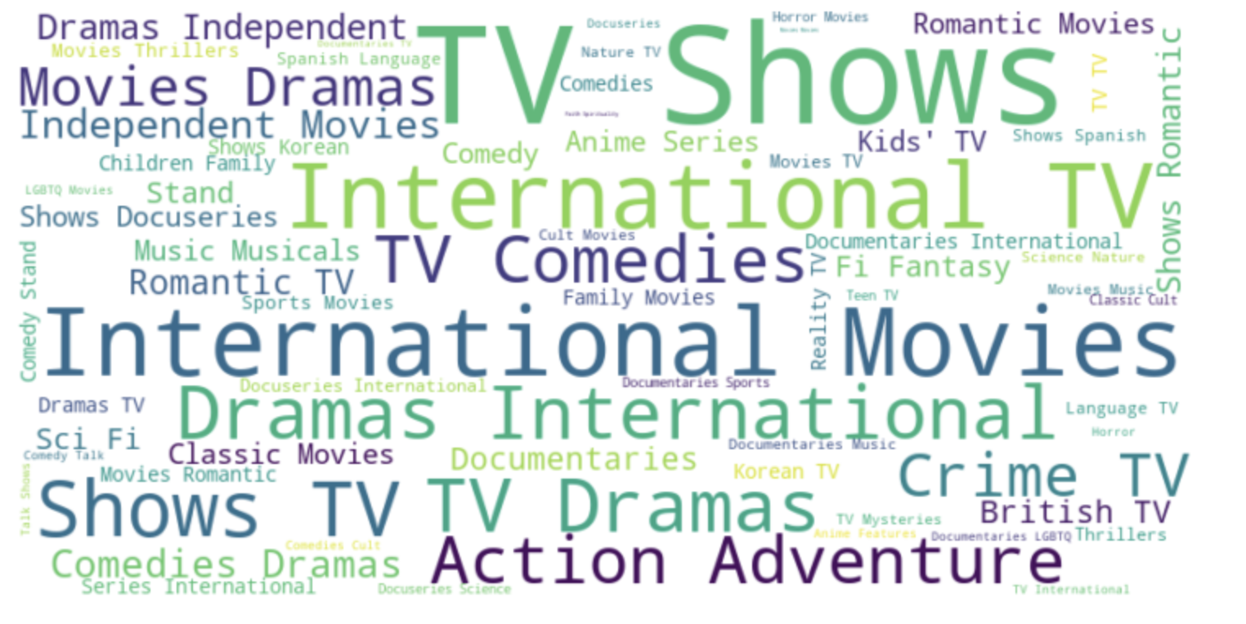
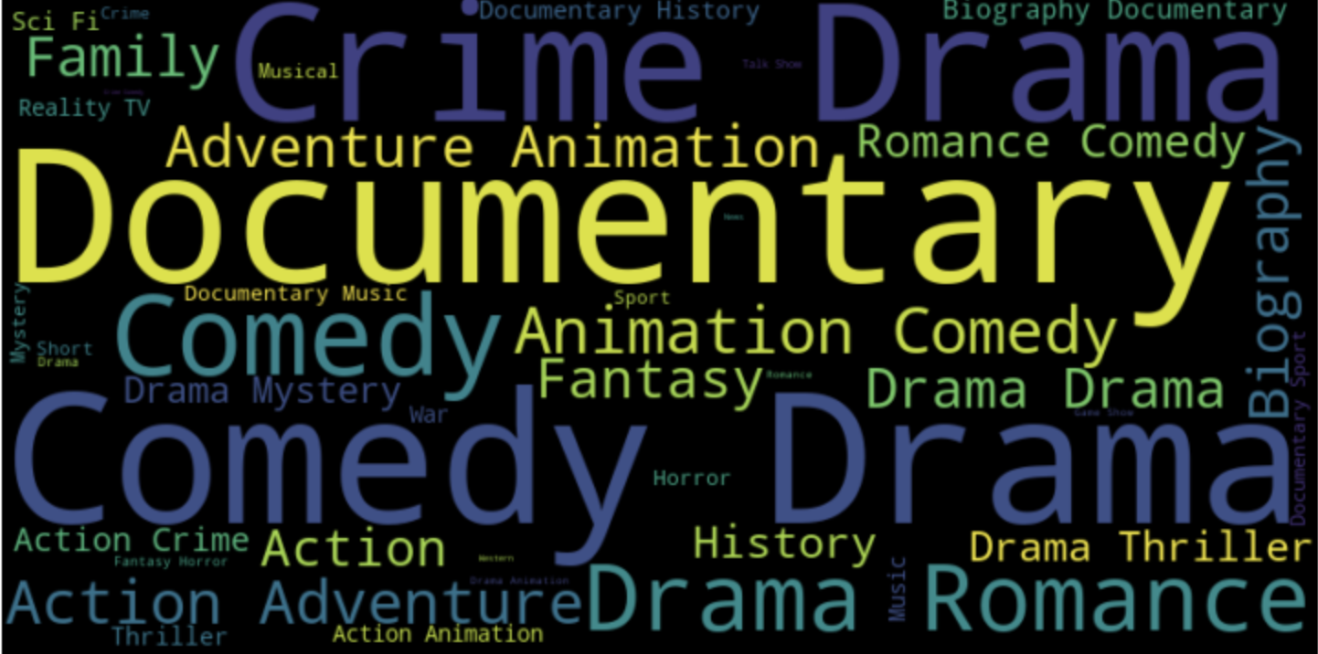
INSIGHT 9
NETFLIX DESCRIPTION
NETFLIX CATEGORIES
IMDB
GENRES

Slide 18
INSIGHT 9
DESCRIPTION / CATEGORIES ? GENRE FINDINGS
Look at the overlap of between the 3 different wordclouds especially between Netflix categories and IMDB genres
Comedy, Crime, Drama, Documentary, Romance, Biography, Family, Animation are genres and categories that perform well on both Netflix and IMDB
So, Netflix should continue to expand on these categories for their catalogue as they generally are enjoyed by many.

Slide 19
CONCLUSION
From all the above insights, it seems Netflix is on a good track that broadcast many enjoyable contents for its viewers
To remain competitive, Netflix should continue to produce its own original TV shows content
Netflix can also think about partnering with international directors with proven good rating contents
and broadcast more contents from other countries such as India, UK, Japan, South Korea as it seems its viewers are
acceptable to watch these countries
If they apply the above suggestions, I believe Netflix will remain ahead of their competitors
as other streaming platforms only just started producing their own content and they are mostly US based.
Even though, I have filtered off the high ratings shows with few votes, I can go again and study that dataset
If I can have more data and determine that those shows are not given many votes
because not many audience are aware of those shows, Netflix can choose to obtain license from those shows
and promote them well in their platform as Netflix has a good recommendation engine built that can market
these shows towards the right audience type

Slide 20
THANKS
Does anyone have any questions?
https://github.com/LiyanaRoslie/ds-netflix-eda

